Slide 1

SpatialEcology and working with DataFrames
GLOBE Institute

Slide 2
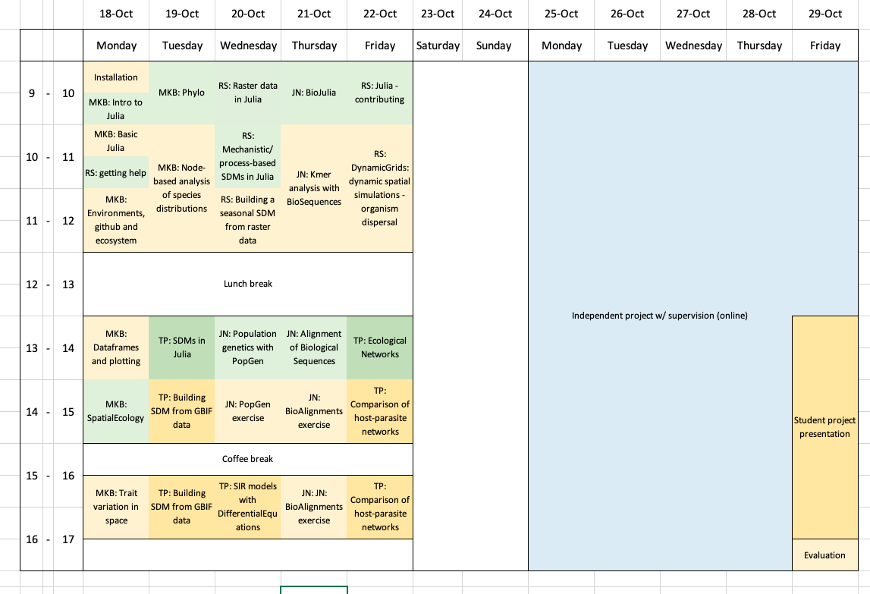

Slide 3
This morning’s schedule
9:15-10: DataFrames – exercise
10:15-11:00 SpatialEcology – live demonstration
11:15-12:00 Phylo and SpatialEcology – exercise
- we’ll talk about git if we have the time – otherwise on Friday
Now: `git pull` in your Julia course folder to get today’s materials

Slide 4
DataFrames and DataFramesMeta
DataFrames are in a package – and there’s even a package for reading them from disk! (CSV)
They work somewhat similarly to tibbles in R, with a slightly different approach to split-apply-combine
Check the cheatsheet in your folder
The DataFramesMeta package uses macros to give a nice dplyr-like interface
Missing values are treated quite differently in Julia

Slide 5

A basic data format that combines
Species occurrences
Spatial locations
Traits
Environmental data
Uses a split–apply–combine strategy with `view`s into data to make macroecological analysis easy
We’ll demonstrate it by going through two analyses

Slide 6
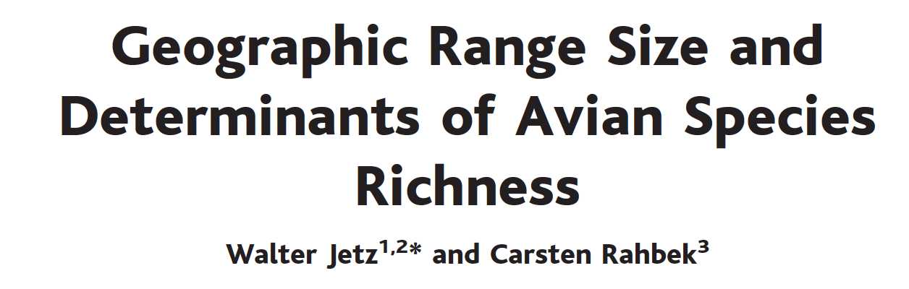
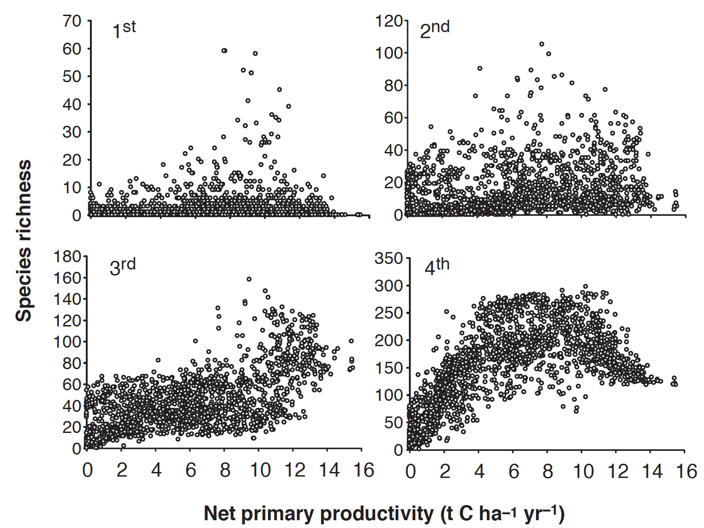
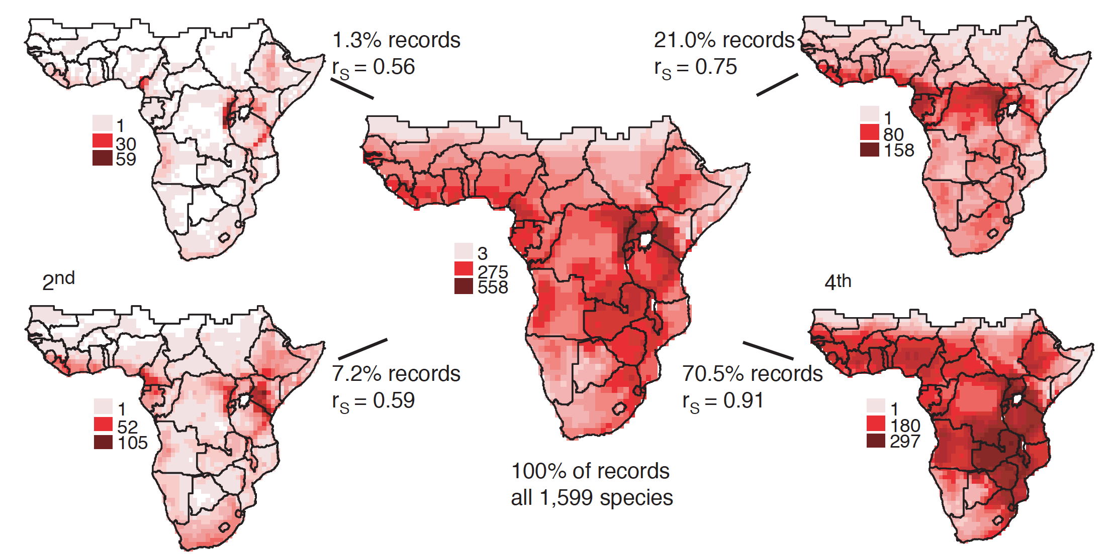

Slide 7
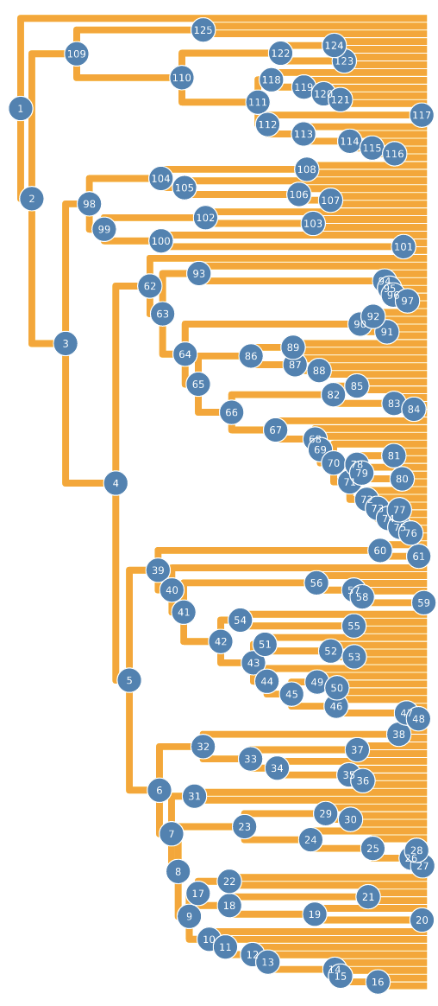
Phylo
A basic package for reading and working with phylogenies
Uses iterators to iterate over nodes
nodenameiter, nodenamefilter
Many functions for building and changing phylogenies
droptip!, createbranch!,
Many functions to follow branches
nodeheights, getdescendants, getchildren, getparent, distances

Slide 8
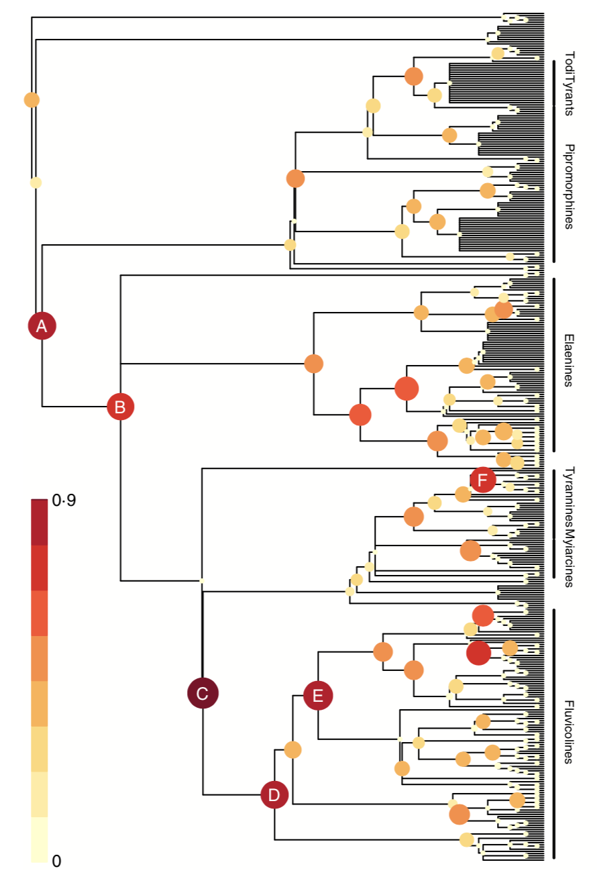
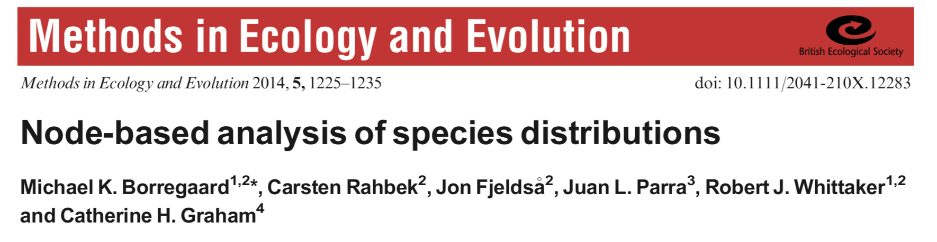
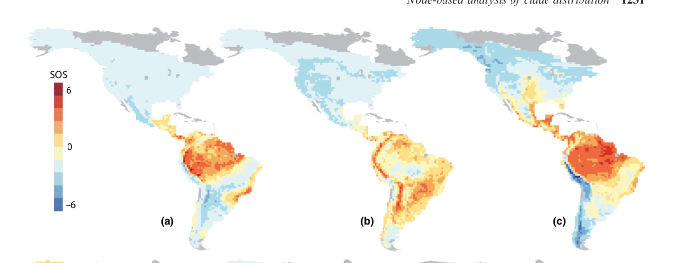

Slide 9
RandomBooleanMatrices
Library for matrix / community randomizations
Legacy matrix randomizations slow and inaccurate
Currently implements ”curveball” (Strona et al 2014) but more advanced algorithms are in process
Including algorithms optimised for the GPU

Slide 10
GIT assignment
Create a new project and environment
Initialize the repo and push it to github
Insert the Julia code you used to solve the dice example. Use two files, one that has the function, one that uses it in a script. Commit and push your change to github with a reasonable message.
On a new branch, edit the function with new functionality, e.g. added dice. Also write a docstring.
Commit and push to the new branch, then make a pull request and merge it.

